Slide 1
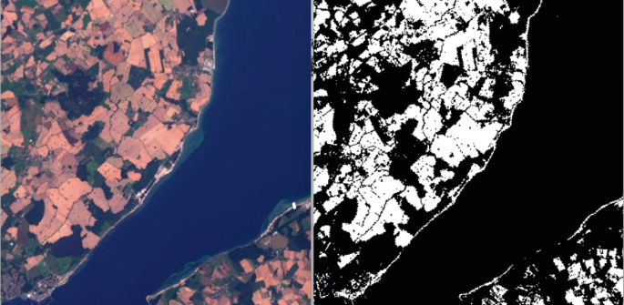
Water Bodies Detection in Satellite Images
Exploring methodologies for detecting water bodies in satellite imagery

Slide 2


Acknowledgements and Team Contributions
TEAM -9
Harsha Vardhan AP21110010980
Mohamed Ameer Roshan
AP21110011021
Nafeez Shaik AP21110011014
^œn'ea 1°nç
preseutotions

Slide 3




Introduction to Water Bodies Detection
Understanding the significance of satellite-based water identification
4
5
Identification of Water Bodies
Using satellite images to locate lakes, rivers, and wetlands.
Analysis of Water Features
Evaluating the characteristics and conditions of identified water bodies.
Environmental Monitoring
Tracking changes in water bodies for ecological health assessments.
Resource Management
Optimizing water resources for sustainable use and conservation.
Disaster Mitigation
Using detection to prepare for and respond to flooding and other water-related disasters.

Slide 4
Importance of Detecting Water Bodies
Effective management of water resources through detection and monitoring
Resource Management
Effective management of water resources requires accurate detection of water bodies to ensure sustainable usage.
Environmental Monitoring
Continuous monitoring of water bodies helps assess environmental impacts and changes due to climate variations.
Urban Planning Support
Detecting water bodies aids urban planners in making informed decisions about
land use and infrastructure development.
Disaster Mitigation
Detection technologies can identify droughts and floods early, enabling timely
responses to mitigate disasters.
^œn'ea 1°nç
preseutotions

Slide 5
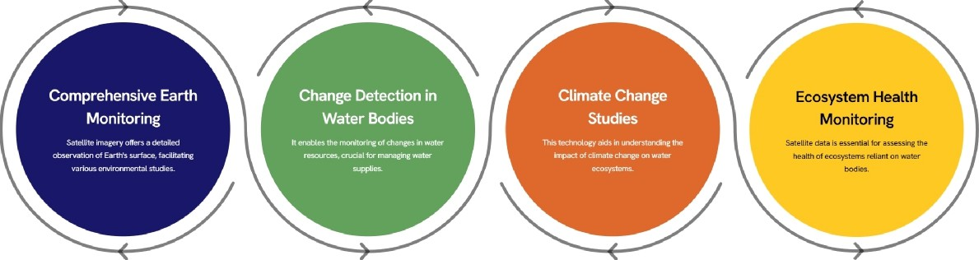
Overview of Satellite Imagery
Understanding Water Bodies Detection through Satellite Technology
^œn'ea 1°nç
preseutotions

Slide 6

Applications of Water Body Detection
Utilizing satellite imagery for effective water management
Environmental Monitoring
Track changes in water resources over time to
ensure sustainable use.
Flood Detection and Management
Provide real-time data for effective flood management and response strategies.
Biodiversity Conservation
Protect aquatic habitats and monitor species
migration patterns effectively.
Water Resource Management
Assess availability of water for agricultural,
industrial, and domestic uses.
Disaster Mitigation
Detect droughts and assess impacts of extreme
weather events on water bodies.
Urban Planning
Identify water bodies for informed zoning and construction planning.
^œna 1°nç
preseutotions

Slide 7
Spatial Filters
Definition: Spatial filtering operates on pixel neighborhoods to modify an image's appearance.
Purpose: It enhances image features or suppresses noise for better quality
Types: Linear (e.g., smoothing, sharpening) and Non-linear (e.g., median filter).
Applications: Used in noise reduction, edge detection, and image enhancement.
Kernel: A small matrix used to apply transformations through convolution.
^œn'ea 1°nç
prseutotions

Slide 8
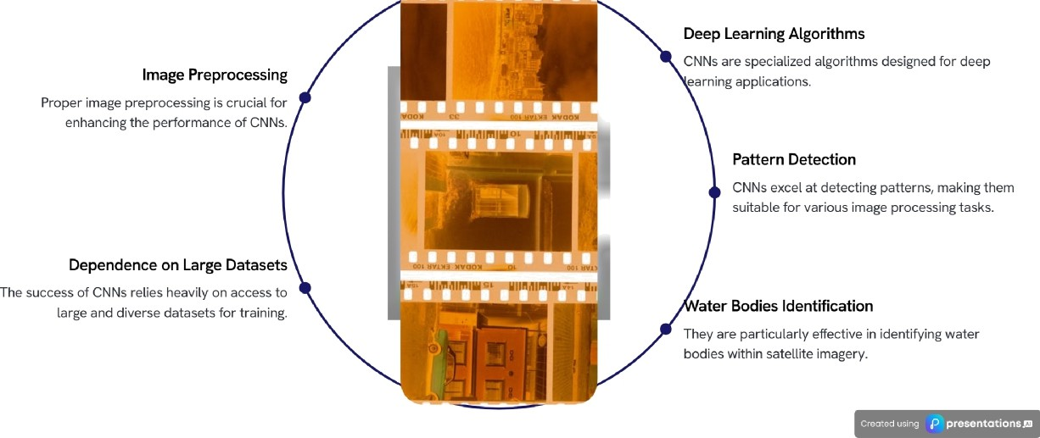
Introduction to Convolutional Neural Networks (CNNs)
Effective Techniques for Detecting Water Bodies in Satellite Imagery

Slide 9
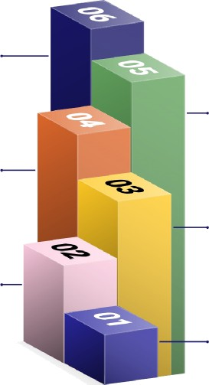
Image Preprocessing for CNNs
Enhancing satellite images for accurate water body detection
Enhancing Features
Improves the visibility of important features in satellite
images.
Removing Noise
Eliminates irrelevant data to clarify the images for better
analysis.
Ensuring Consistency
Standardizes image formats and quality for reliable data
comparison.
Converting to Grayscale
Simplifies image data by reducing color information while
maintaining essential details.
Resizing Images
Adjusts image dimensions to fit processing requirements
and improve computational efficiency.
Applying Filters
Uses various filters to enhance details and reduce unwanted artifacts in the images.
^œn'ea 1°nç
preseutotions

Slide 10
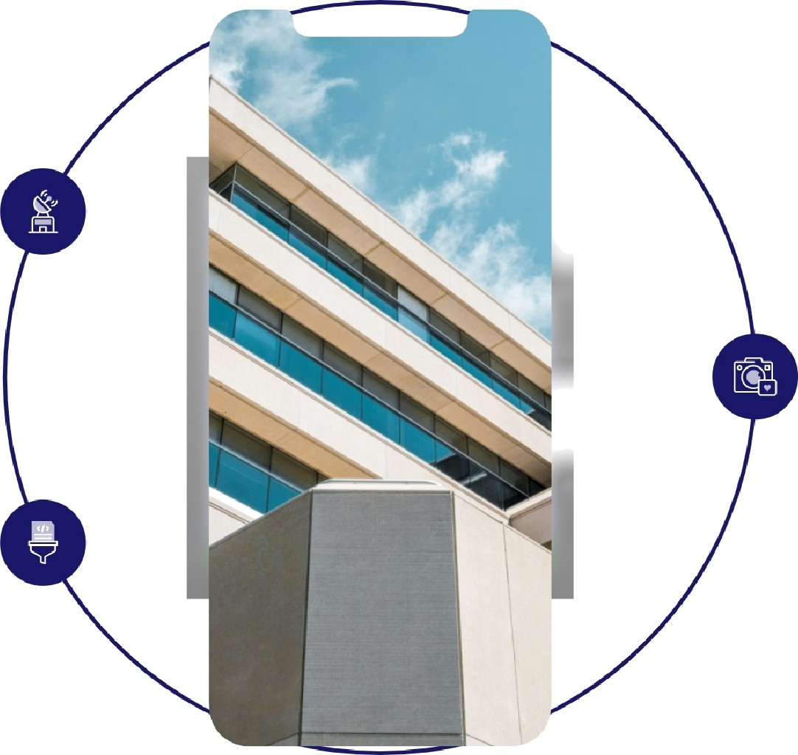
Challenges in Water Bodies Detection
Variability in Appearance:
Water bodies can lookdifferent due to lighting conditions, turbidity, and reflections fromthe sun or surrounding objects..
Cloud Cover and Haze:Satellite images often have clouds or haze that obscure water bodies, making detection unreliable
Distinguishing Features:
Differentiating water from similar dark features like shadows, asphalt, or dense vegetation is difficult..

Slide 11
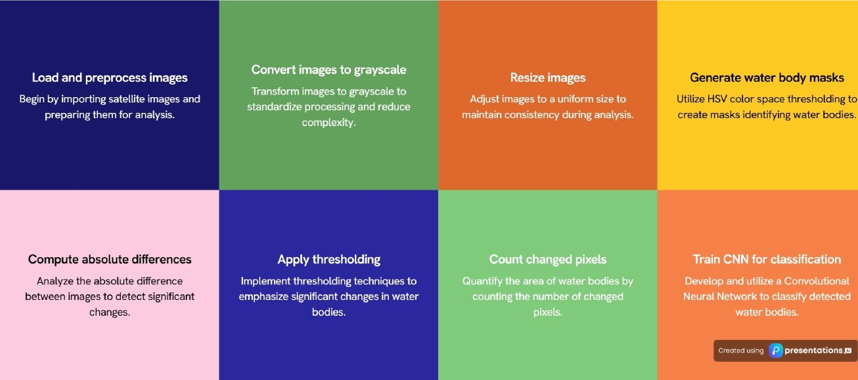
Methodology for Water Body Detection
A step-by-step approach to identifying water bodies in satellite imagery

Slide 12
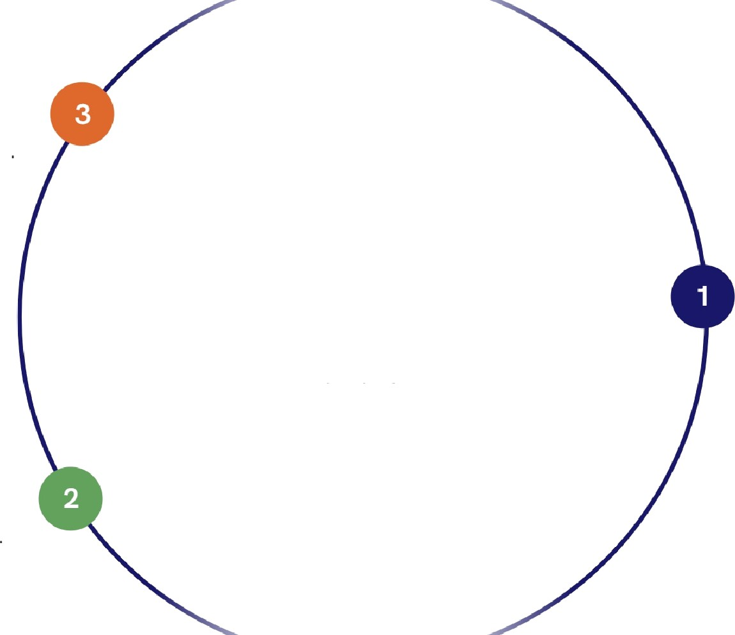
Spatial Data Collection:
Collect pre-flood and post-flood high-resolution satellite images (e.g., Sentinel-1, Landsat).
Case Study: Flood Detection
Leveraging CNNs for Real-time Satellite Image Analysis
Water Body Detection:
Use Cnn to identify water regions based on spectral and spatial features.
Spatial Image Preprocessing:
Noise Removal: Minimize atmospheric interference (e.g., clouds, haze).
Spatial Alignment:Align images to ensure geographical consistency.
^œn'ea 1°nç
reseutotions

Slide 13
Future Directions in Water Body Detection
Integrating advanced technologies for enhanced monitoring
Integration of Machine Learning
Applying machine learning techniques to analyze satellite images for improved detection of water bodies.
Advancements in Satellite Technology
Utilizing the latest satellite technologies to capture high-resolution images and data for effective water body monitoring.
Real-time Data Processing
Implementing real-time processing of satellite data to enhance responsiveness and accuracy in water resource management.
Ongoing Research Initiatives
Continuous research efforts aimed at refining detection methods to increase accuracy and operational efficiency.
Enhanced Monitoring Capabilities
Improving the ability to monitor water resources effectively through the integration of advanced technologies.
^œn'ea 1°nç
pretotions

Slide 14










Conclusion: The Power of CNNs in Water Body Detection
Revolutionizing water body monitoring with advanced technology
Enhanced Detection Capabilities
CNNs improve the accuracy of detecting water bodies in satellite images, allowing for better
resource management.
Sustainable Resource Management
By effectively monitoring water resources, CNNs contribute to sustainable management practices for future generations.
Technological Advancements
Ongoing advancements in CNN technolo will further enhance the precision an
range of water body detectio
application
^œn'ea 1°nç
preseutotions

